Slide 1

WEL COME
.

Slide 2
INTRODUCTION
Mohammad abul hossain
Assistant teacher(English)
Ghagotia Chala High school
Kapasia,Gazipur
Subject-English 1st paper
Class-nine
Unit-o8
Lesson-o3
Time-50minutes
Date-17-02-2014

Slide 3

What do you see in the picture?
.
.

Slide 4
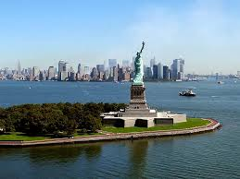
.
.
‘

Slide 5
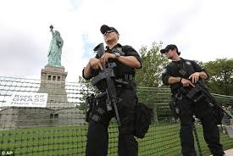
‘
.
‘

Slide 6
ANNOUNCEMENT THE LESSON
After showing the picture
T will announcement todays lesson.today’s lesson is
“THE STATUE OF LIBERTY”
Page-106
.

Slide 7
Learning outcomes
After reading the lesson the ss will able to learn………….
“SS”will able to learn where it is situated.
SS will able to say Which country gave the statue as a gift.
Ss will able to describe the statue of liberty.

Slide 8
PRESENTATION
T Wil tell the ss to listen the lesson silently and carefully after listen it ss will answers the chart’
Statue of liberty information
Situated……………………………………………………………
Artist…………………………………………………………………..
Gift from……………………………………………………………
Reason for the gift……………………………………………..
Occasion……………………………………………………………..
Weight………………………………………………………………..

Slide 9
INDIVIDUAL WORK
1.on what occasion did the French government give the statue of liberty to the USA.

Slide 10
GROUP WORK
1.When and which country gifted the statue of liberty? 2.How many days was needed to put the statue together on the pedestal ? SS will answer it.

Slide 11
EVUALUATION
Why the statue of liberty was gifted?
Where it is situated?
What does the statue represent?

Slide 12
HOME WORK
Do you think the statue of liberty is significant for the people ? How has new technology made it possible to see it any where write your own opinion.

Slide 13


THANK YOU EVERY BODY
.

